Slide 1
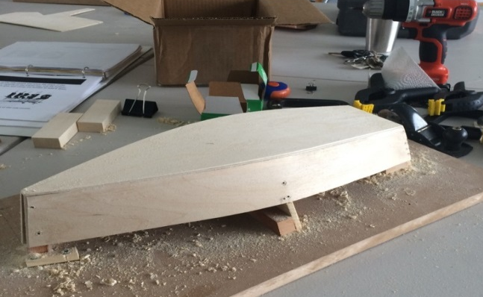
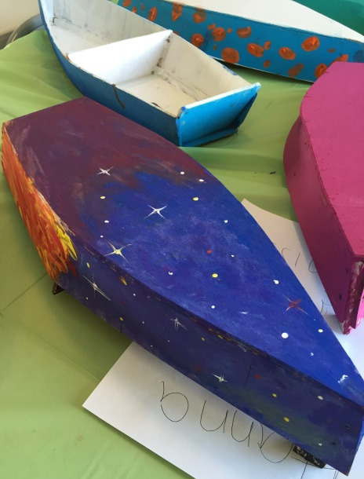
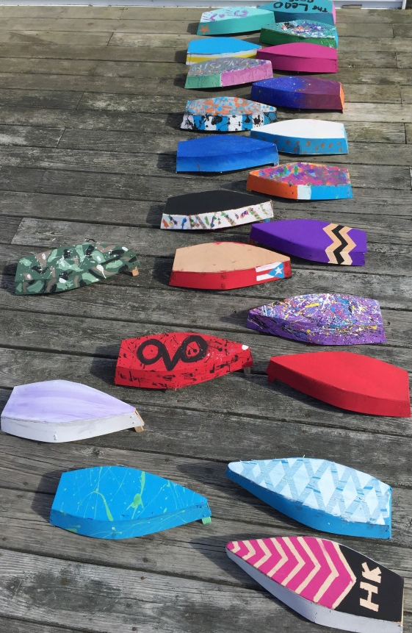
Model Boatbuilding With CBC
Who? New Bedford Community Boating Center, Inc. and You Recommended for grades 5 and up What? Build a model boat and take it home when you are done. Day 1 – Drill Master – drill holes, screw and glue Day 2 – Plane Master – plane the wood and glue on the bottom Day 3 – Sawyer – Saw the boat off the building board Day 4 – Party to celebrate your work Where? Dennison Memorial Community Center When? 1 pm daily Tuesday, February 21 – Friday, February 24, 2017.

